Slide 1
SELT Grad Program Application
Team 5 - Alan, Zach, Thomas, Cole and Max

Slide 2
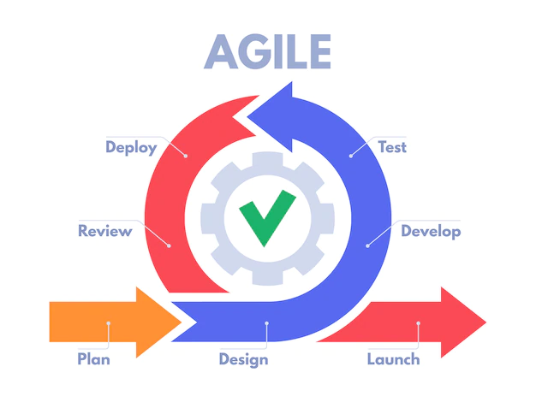
Process - Agile
Lead Dev - Alan
Sprint 1 - SM: Thomas, PO: Zach
Sprint 2 - SM: Cole, PO: Max
Sprint 3 - SM: Zach, PO: Alan
4 meetings/week
Sprint planning
Retro meeting - based on our feedback
Focus
Working software over heavy documentation
Welcoming change each week when new struggles encountered
Constantly referring back to the documentation in order to ensure customer satisfaction

Slide 3
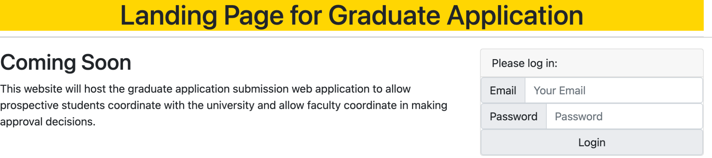
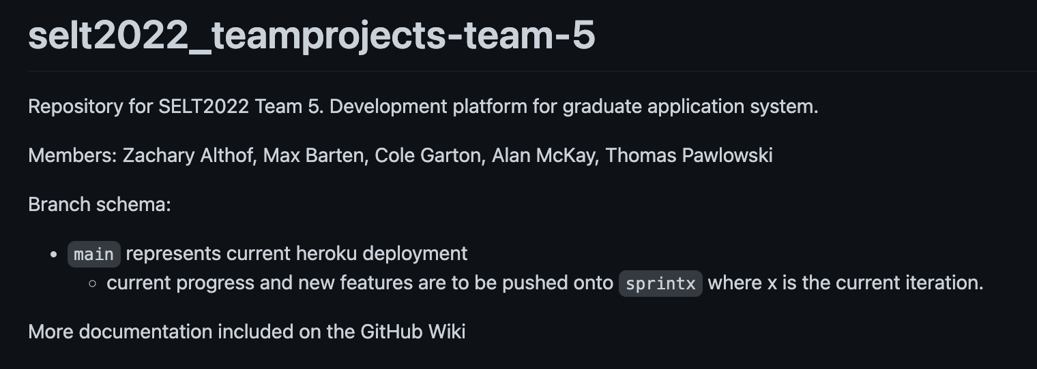
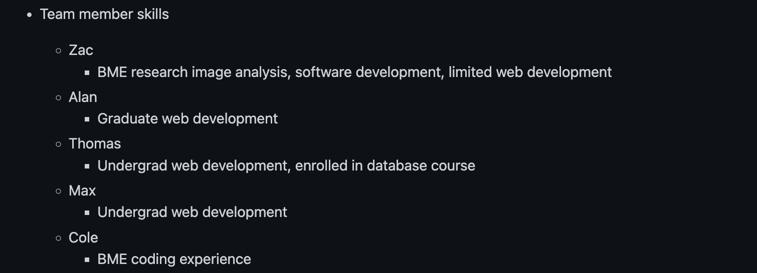
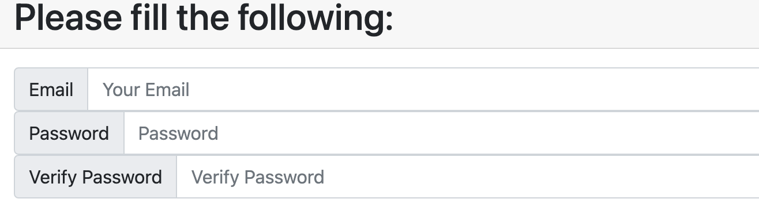
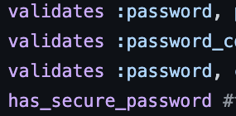
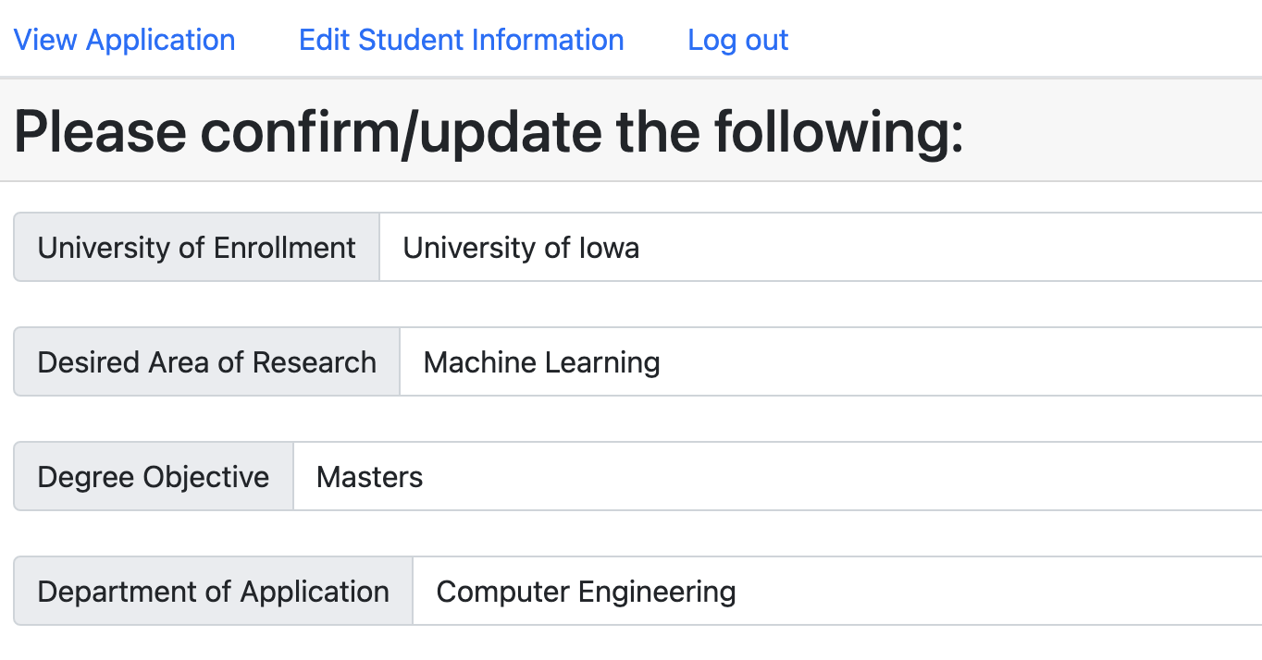
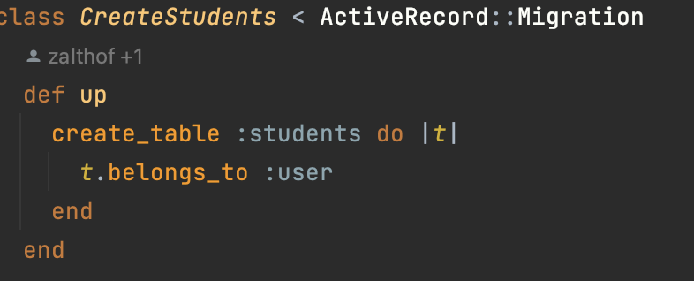
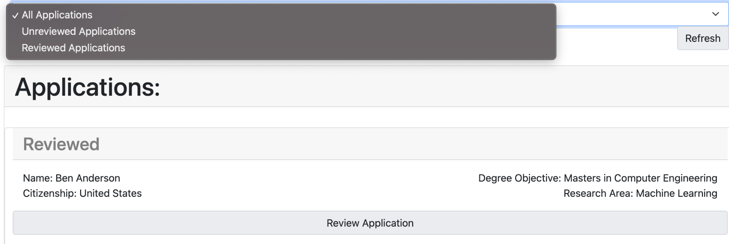
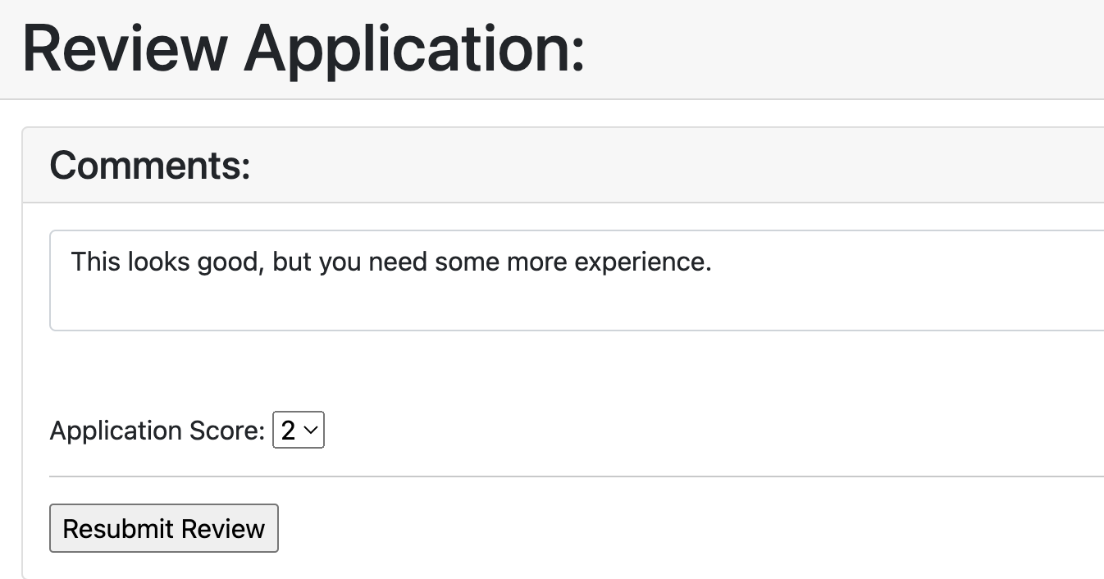
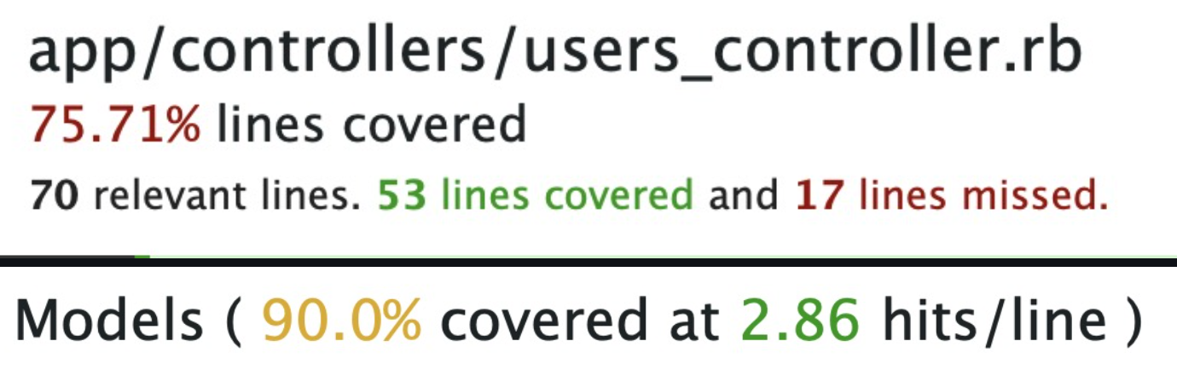
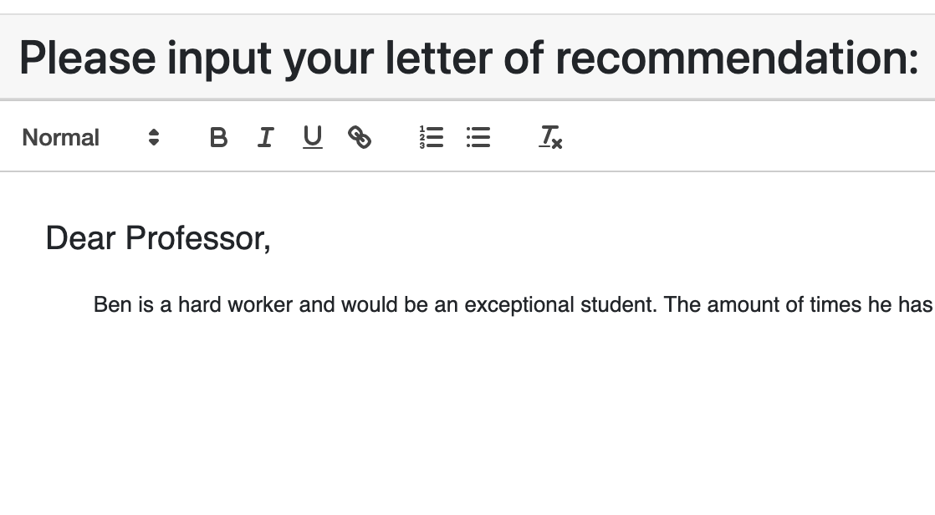
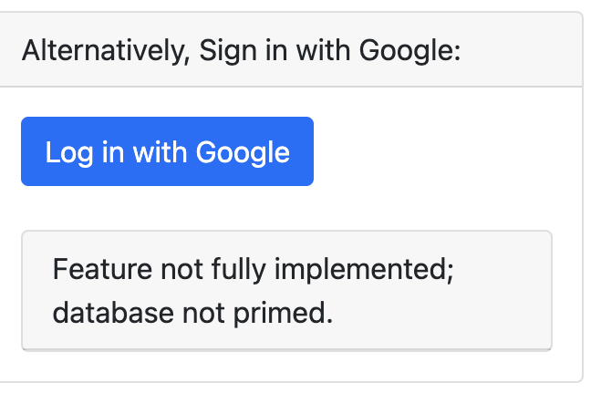
Process - Goals + Achievements
Sprint 1 goals: landing page, setting up our process, working towards everyone’s strengths,
Sprint 2 goals: Account creation, user handling, password encryption, grad application and student views, and database integration
Sprint 3 goals: Student and grad application integration, faculty views, grad application reviews, additional testing, letters of recommendation, and 3rd party authentication.

Slide 4
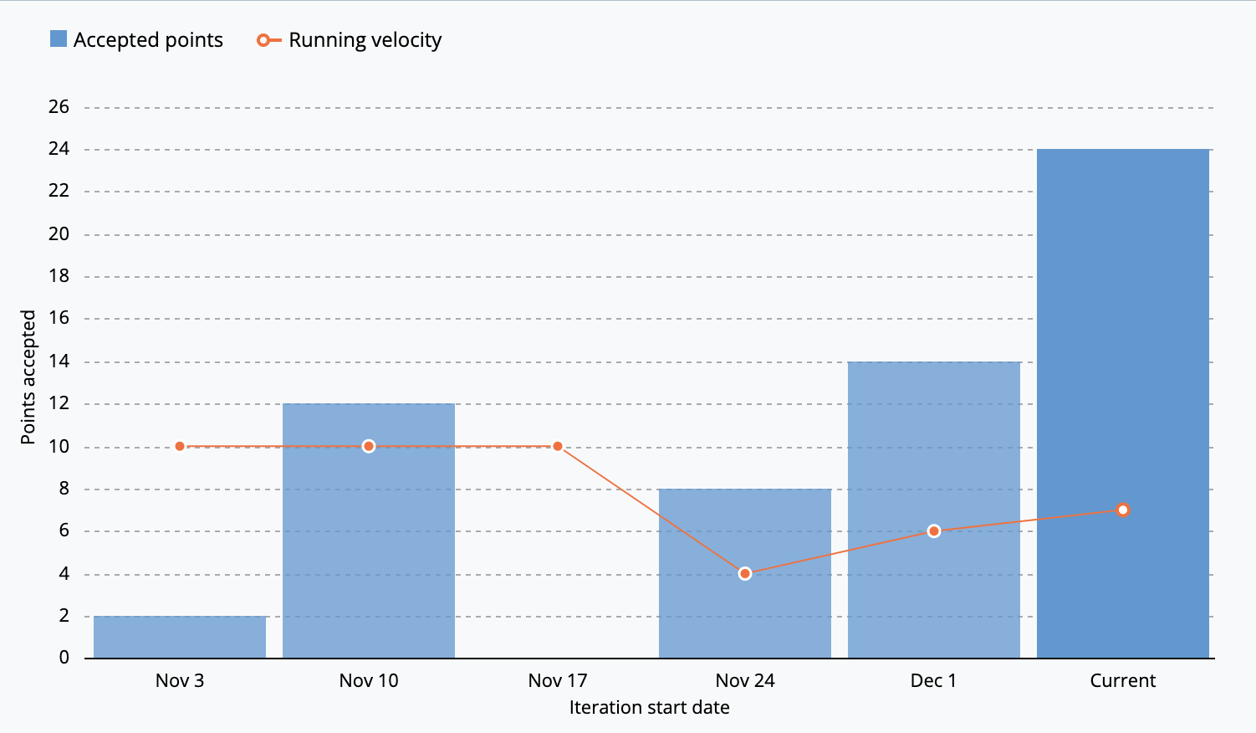
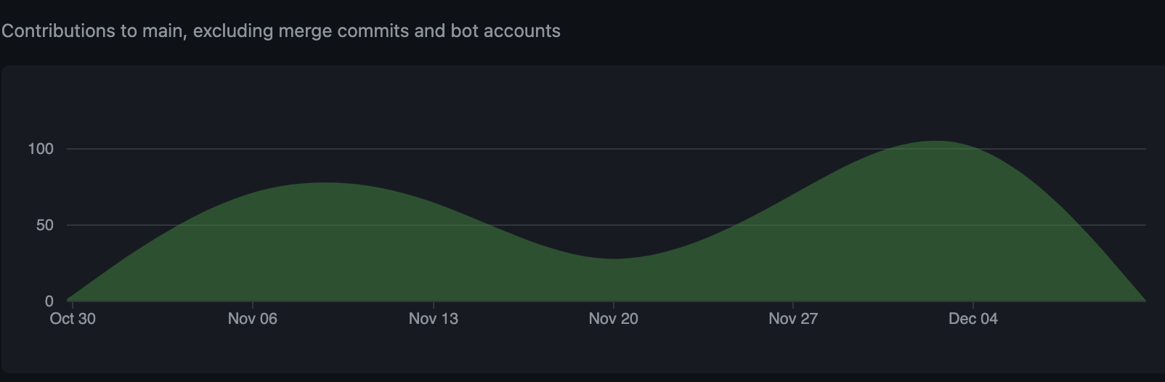
Process - Git + Pivotal Tracker
PR created for each user story
Required all team members to approve a PR into main
PO accepted user stories when PR for each feature was approved and merged
Git Insights:
5 authors have pushed 372 commits to main. On main, 145 files have changed and there have been 8,976 additions and 3,966 deletions.
~50 pull requests
Last month of contributions

Slide 5
Process - Lessons Learned
To be improved:
Pivotal tracker
TDD
To be continued:
Achievable goal setting
Communication
Pair programming
User story driven development
Notes:
Use pivotal tracker more to better quantify progress and velocity
Design testing before development to avoid having to rewrite code and ensure compatibility to other developer components
Setting achievable goals allowed us to break up the project into digestible segments and led to focused development and improved moral achieving our goals each iteration
Consistent meetings and teams chat between allowed for developers to help each other and made sure everyone knew what others were working on
User story driven development allowed us to focus on making the site function as the customer desired instead of getting bogged down on implementation details

